Slide 1
Lecture 1 Mathematical preliminaries
EECS-214

Slide 2
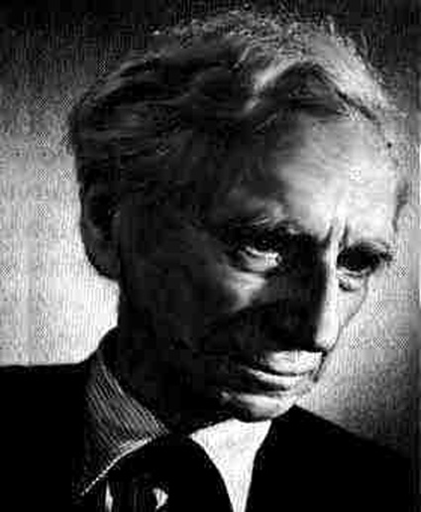
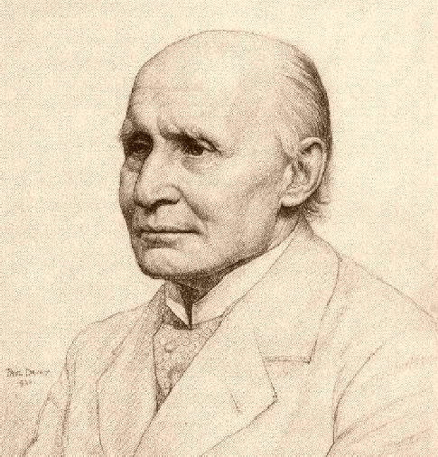
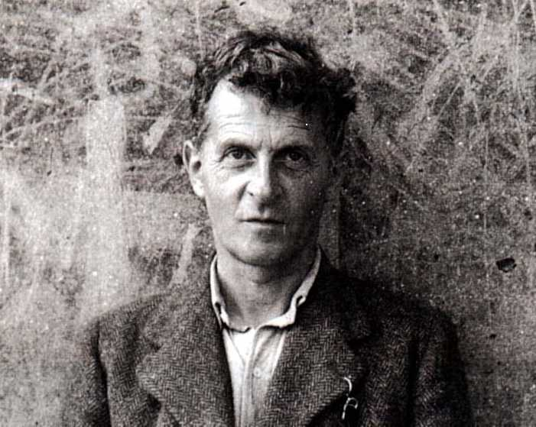
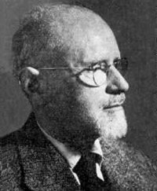
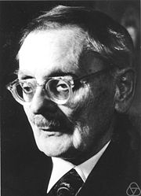
Sets
Since the early 20th century, most of mathematics has been described in terms of set theory
Common vocabulary for describing a wide range of different mathematical objects
Numbers, languages, trees
Functions (and you can describe almost anything in terms of functions)
Partial history
1910 Russell and Whitehead defined arithmetic, calculus, etc. in terms of sets, but it has some bad bugs
1917 Wittgenstein fixes some of its bugs; concludes art and poetry are ultimately more important
1930 Zermelo and Fraenkel fixed some more, giving us the modern version of set theory

Slide 3
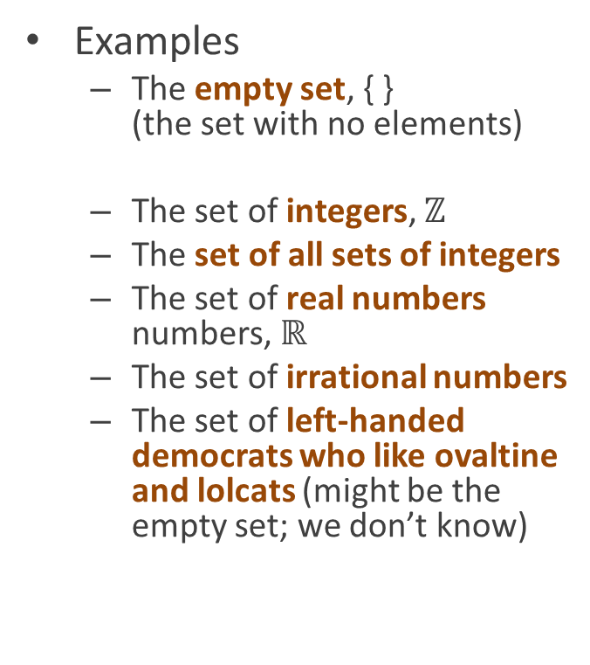
Sets
Unordered collections of “elements”
Any objects you might want to think about mathematically
Including other sets
Numbers, colors, people, whatever
Often notated with curly braces
{ a, b, c, d }
Read: “the set whose elements are a, b, c, d”
Examples
The empty set, { } (the set with no elements)
The set of integers, $ℤ$
The set of all sets of integers
The set of real numbers numbers, $ℝ$
The set of irrational numbers
The set of left-handed democrats who like ovaltine and lolcats (might be the empty set; we don’t know)

Slide 4

Basic concepts
Membership Whether a set has a given object as a member
If x is an element of the set S, we write: x∈S
Or if it isn’t, x∉S
Subset/superset Whether one set has all the members of another set
If big set B has all the members of smaller set S, we say:
S is a subset of B
Or: S is contained in B
B is a superset of S
S ⊆ B (subset or same) or S ⊂ B (strict subset)
B ⊇ S (superset or same) or B ⊂ S (strict superset)
B
S
$$S⊂B$$

Slide 5
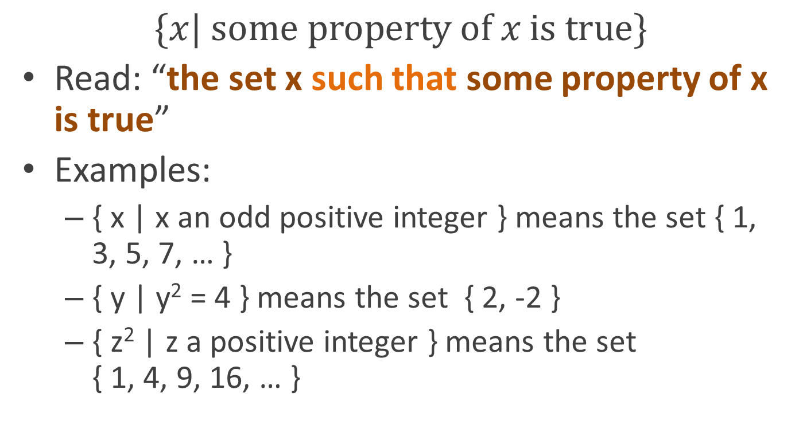
Predicated set notation
$$\{x| \text{some} \text{property} \text{of} x \text{is} \text{true}\}$$
Read: “the set x such that some property of x is true”
Examples:
{ x | x an odd positive integer } means the set { 1, 3, 5, 7, … }
{ y | y² = 4 } means the set { 2, -2 }
{ z² | z a positive integer } means the set { 1, 4, 9, 16, … }

Slide 6
Theoretical aside: predicated set notation can cause problems
Bertrand Russell was given a lot of trouble by the set of all sets who don’t contain themselves and members: { S | S ∉ S }
Fortunately, we can ignore this issue

Slide 7
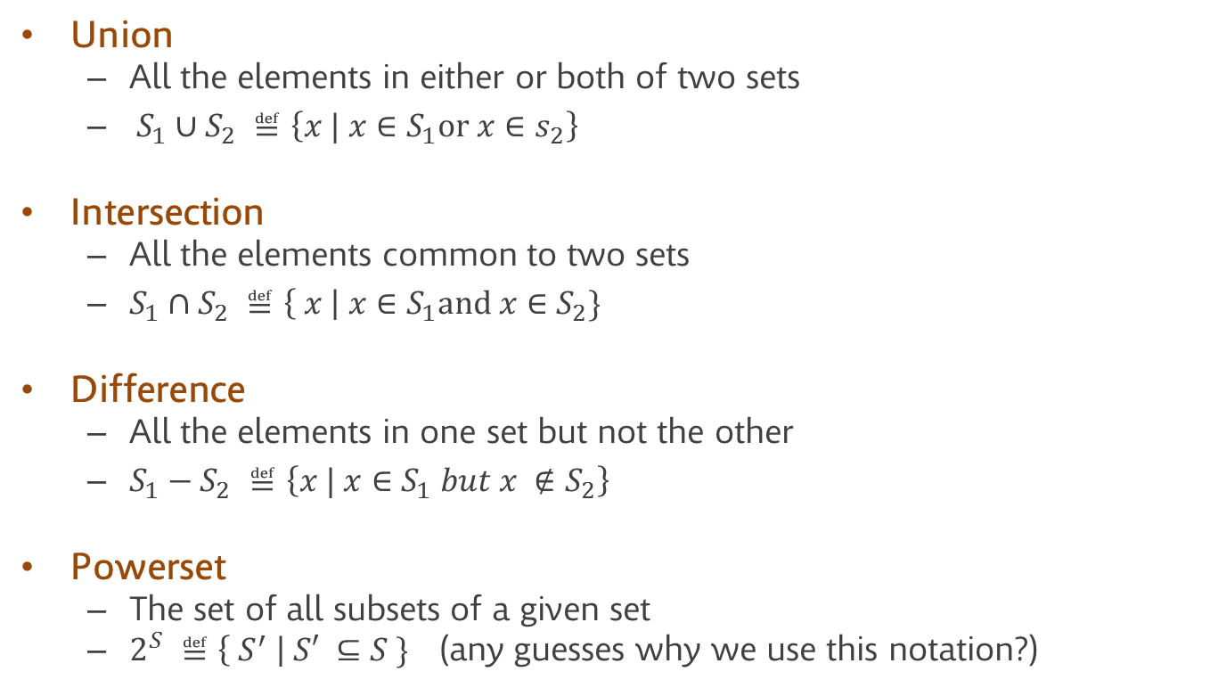
Basic operations on sets
Union
All the elements in either or both of two sets
$S_{1}∪S_{2} ≝\left\{x | x∈S_{1}\text{or} x∈s_{2}\right\}$
Intersection
All the elements common to two sets
$S_{1}∩S_{2} ≝\left\{ x \right| x∈S_{1}\text{and} x∈S_{2}\}$
Difference
All the elements in one set but not the other
$S_{1}−S_{2} ≝\left\{x | x∈S_{1} but x ∉S_{2}\right\}$
Powerset
The set of all subsets of a given set
$2^{S} ≝\left\{ S^{′} \right| S′ ⊆S \}$ (any guesses why we use this notation?)

Slide 8
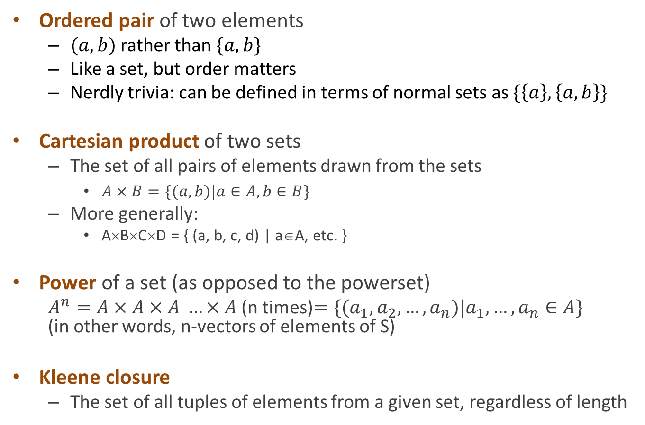
Building sequences from sets
Ordered pair of two elements
$(a,b)$ rather than $\{a,b\}$
Like a set, but order matters
Nerdly trivia: can be defined in terms of normal sets as $\{\left\{a\right\}, \left\{a,b\right\}\}$
Cartesian product of two sets
The set of all pairs of elements drawn from the sets
$A×B=\{(a,b)|a∈A, b∈B\}$
More generally:
A×B×C×D = { (a, b, c, d) | a∈A, etc. }
Power of a set (as opposed to the powerset)
$A^{n}=A×A×A …×A$ (n times)$=\{(a_{1},a_{2},…,a_{n})|a_{1},…,a_{n}∈A\}$ (in other words, n-vectors of elements of S)
Kleene closure
The set of all tuples of elements from a given set, regardless of length

Slide 9
Relations
Students
A relation between two sets is a property that might hold between some elements of the sets, but not others
Example
Given the set of all college students, S, and the set of all colleges, C,
Attendance is a relation between elements of S and elements of C
For any s∈S, c∈C, we can ask whether s attends c
If R is some relation, we’ll write xRy to mean “R holds between elements x and y”
E.g. if A = attendance, then you would write sAc to mean “s attends c”
You
Schools
Northwestern

Slide 10
Relations as sets
Students
Relations are usually formalized in set theory as sets of pairs
In particular, the pairs of things that are related
Then xRy just means (x,y)∈R
We can mostly ignore this
You
Schools
Northwestern

Slide 11
Special kinds of relations
A lot of the most useful relations are the ones that hold between elements of the same set
For example, for the integers, we have the relations
Equality: x = y
Ordering: x ≤ y

Slide 12
Properties of relations
Equality
Reflexivity
x=x
Transitivity
If x=y and y=z
Then x=z
Symmetry
If x=y, then y=x
Ordering
Reflexivity
x ≤ x
Transitivity
If x ≤ y and y ≤ z
Then x ≤ z
Antisymmetry
If x ≤ y, and y ≤ x
Then x = y
Totality
For any x, y
Either x ≤ y or y ≤ x (or both)

Slide 13
Generalizing relations
Much of mathematics is about abstracting or generalizing familiar notions
What happens if we have a relation that’s like a familiar one, but different
Equivalence relation
Any relation that satisfies reflexivity, transitivity, and symmetry
Acts like =
Partial orderings
Any relation that satisfies reflexivity, transitivity, and antisymmetry
Acts like ≤
Total orderings
Any partial ordering that also satisfies totality

Slide 14
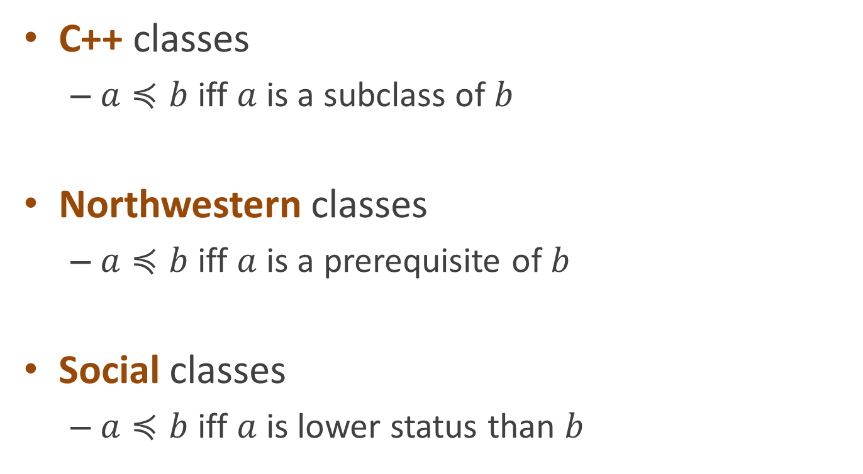
Examples of partial orderings
C++ classes
$a≼b$ iff $a$ is a subclass of $b$
Northwestern classes
$a≼b$ iff $a$ is a prerequisite of $b$
Social classes
$a≼b$ iff $a$ is lower status than $b$

Slide 15
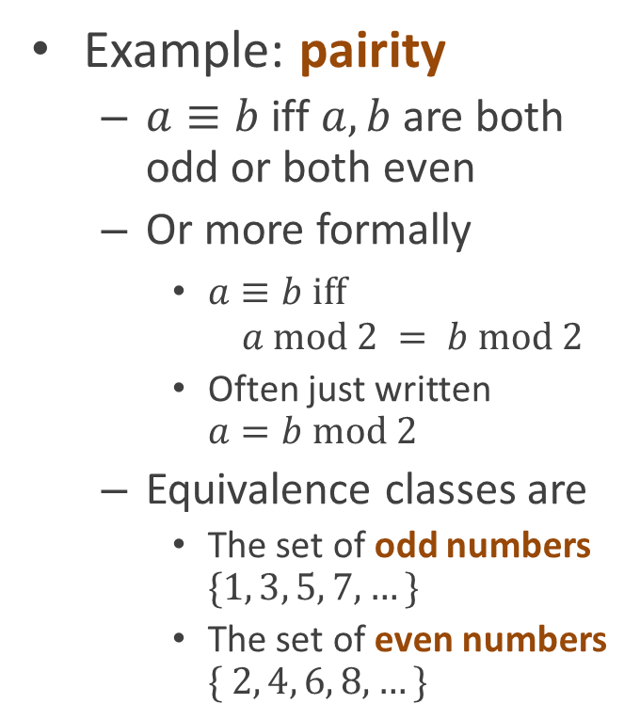
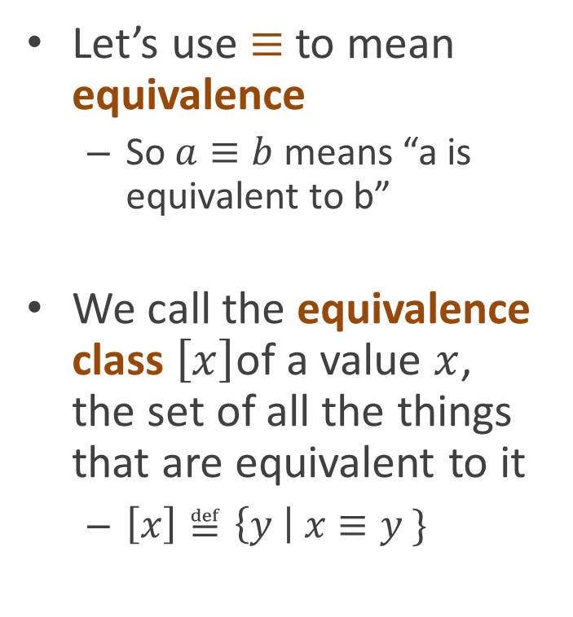
Equivalence relations
Let’s use $≡$ to mean equivalence
So $a≡b$ means “a is equivalent to b”
We call the equivalence class $\left[x\right]$of a value $x$, the set of all the things that are equivalent to it
$\left[x\right]≝\left\{y \right| x≡y \}$
Example: pairity
$a≡b$iff $a, b$ are both odd or both even
Or more formally
$a≡b \text{iff}$ $a \text{mod} 2 = b \text{mod} 2$
Often just written $a=b mod 2$
Equivalence classes are
The set of odd numbers $\{1, 3, 5, 7, …\}$
The set of even numbers $\{ 2, 4, 6, 8, …\}$

Slide 16

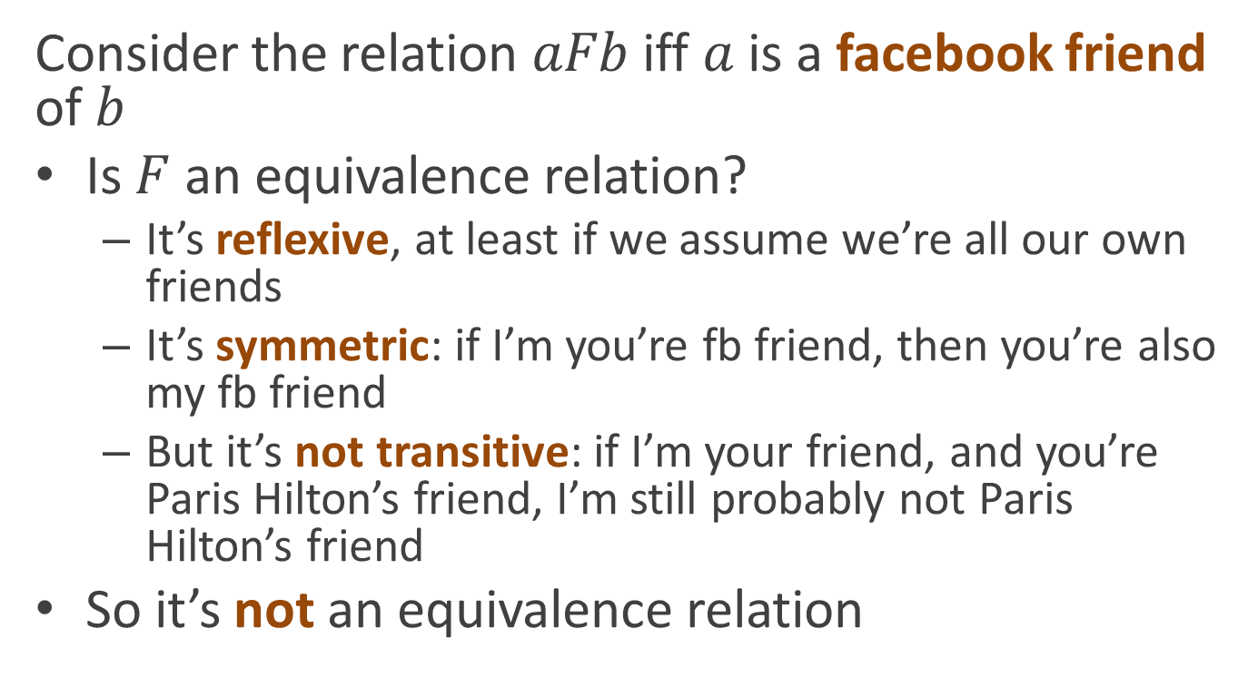
Consider the relation $aFb$ iff $a$ is a facebook friend of $b$
Is $F$ an equivalence relation?
It’s reflexive, at least if we assume we’re all our own friends
It’s symmetric: if I’m you’re fb friend, then you’re also my fb friend
But it’s not transitive: if I’m your friend, and you’re Paris Hilton’s friend, I’m still probably not Paris Hilton’s friend
So it’s not an equivalence relation

Slide 17
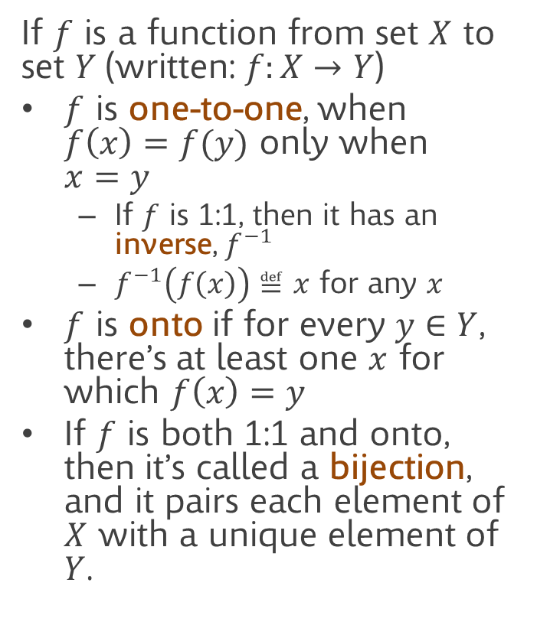
Functions
Functions are probably more important than relations
But you’re also probably more familiar with them, so we’ll say less about them here
Functions can also be viewed as relations
Think of F(x)=y as a shorthand for xFy
And since relations can be formalized as sets, that means functions can too
If $f$ is a function from set $X$ to set $Y$(written: $f:X→Y$)
$f$ is one-to-one, when $f\left(x\right)=f(y)$ only when $x=y$
If $f$ is 1:1, then it has an inverse, $f^{−1}$
$f^{−1}\left(f\left(x\right)\right)≝x$ for any $x$
$f$ is onto if for every $y∈Y$, there’s at least one $x$ for which $f\left(x\right)=y$
If $f$ is both 1:1 and onto, then it’s called a bijection, and it pairs each element of $X$ with a unique element of $Y$.

Slide 18
Functions
X
Y
X
Y
1:1 (but not onto) function
onto (but not 1:1) function

Slide 19
Functions
X
Y
1:1 onto function (aka a bijection)

Slide 20
Graphs
Informally, a graph is a network of objects connected by lines or arrows
The objects are called nodes or vertices and the lines are called edges

Slide 21
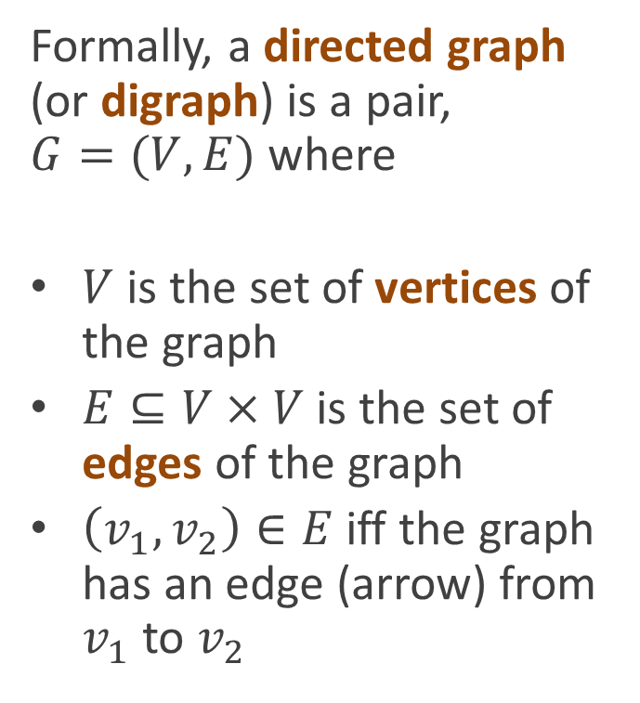
Graphs
Formally, a directed graph (or digraph) is a pair, $G=(V,E)$ where
$V$ is the set of vertices of the graph
$E⊆V×V$ is the set of edges of the graph
$\left(v_{1}, v_{2}\right)∈E$ iff the graph has an edge (arrow) from $v_{1}$ to $v_{2}$
Note: you can also think of a digraph as a relation on the vertices

Slide 22
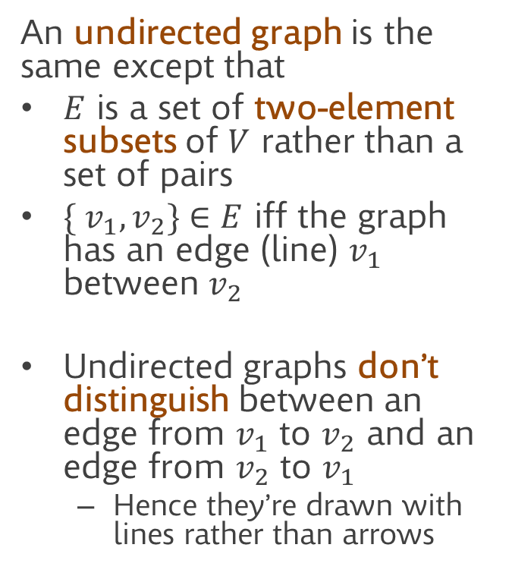
Graphs
An undirected graph is the same except that
$E$ is a set of two-element subsets of $V$ rather than a set of pairs
$\{ v_{1}, v_{2}\}∈E$ iff the graph has an edge (line) $v_{1}$ between $v_{2}$
Undirected graphs don’t distinguish between an edge from $v_{1}$ to $v_{2}$ and an edge from $v_{2}$ to $v_{1}$
Hence they’re drawn with lines rather than arrows
Note: you can also think of an undirected graph as a symmetric relation on the vertices

Slide 23
Subgraphs
A subgraph is just a graph whose edges and vertices subsets of the vertices and edges of some other graph

Slide 24
Subgraphs
A subgraph is just a subset of the vertices and/or edges of some other graph

Slide 25
Subgraphs
A subgraph is just a subset of the vertices and/or edges of some other graph

Slide 26
Subgraphs
A subgraph is just a subset of the vertices and/or edges of some other graph

Slide 27
Adjacency
Two vertices linked by an edge are said to be adjacent

Slide 28
Paths
A path is a series of adjacent vertices that doesn’t repeat the same vertex
For a directed graph, the path has to follow the direction of the edges
Two vertices are connected, if there is a path between them

Slide 29
Connectivity
A graph is connected if every vertex in the graph is connected to every other vertex

Slide 30
Connected components
Not all graphs are connected

Slide 31
Connected components
Not all graphs are connected
The connected components of a graph are the largest subgraphs of the graph you can form that are themselves connected

Slide 32
Cycles
A cycle is a path that starts and ends with the same vertex
(Okay, I know we said paths can’t repeat the same vertex, but we’ll allow the first and the last to be the same)
A graph is cyclic if it contains at least one cycle

Slide 33
Cycles
A cycle is a path that starts and ends with the same vertex
(Okay, I know we said paths can’t repeat the same vertex, but we’ll allow the first and the last to be the same)
A graph is cyclic if it contains at least one cycle
(This graph has 2 cycles)

Slide 34
Trees
A tree is a graph in which
Any pair of nodes has
Exactly one path between them

Slide 35
Rooted trees
In computer science, we usually think of trees as having a distinguished node called the root

Slide 36
Rooted trees
In computer science, we usually think of trees as having a distinguished vertex called the root
And we draw it
With the root at the top
And other vertices arranged by their distance from the root
Note: you can also think of a rooted tree as a partial order on the vertices

Slide 37
Children
The nodes adjacent to a node, but at the next lower depth are called its children
Note: node and vertex are synonyms

Slide 38
Children
The nodes adjacent to a node, but at the next lower depth are called its children
And the nodes that are its children, children’s children, etc., are called its descendants

Slide 39
Parents and ancestors
The nodes above a node in the tree are its ancestors
The node immediately above a node in the tree is its parent
All nodes have parents except the root
Nodes with the same parent are called siblings

Slide 40
DAGs
Directed Acyclic Graphs or DAGs are directed graphs that don’t have cycles
They’re a lot like trees

Slide 41
DAGs
Directed Acyclic Graphs or DAGs are directed graphs that don’t have cycles
They’re a lot like trees
Only the can “rejoin” branches together

Slide 42
DAGs
Directed Acyclic Graphs or DAGs are directed graphs that don’t have cycles
They’re a lot like trees
Only the can “rejoin” branches together
But they can’t have cycles

Slide 43
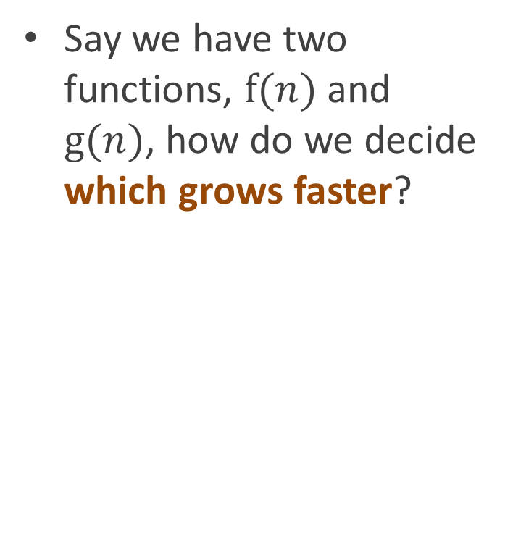
Asymptotic analysis
Say we have two functions, $f(n)$ and $g(n)$, how do we decide which grows faster?

Slide 44

Asymptotic analysis
Say we have two functions, $f(n)$ and $g(n)$, how do we decide which grows faster?
$$\lim_{n→∞}{\frac{f(n)}{g(n)}}$$

Slide 45

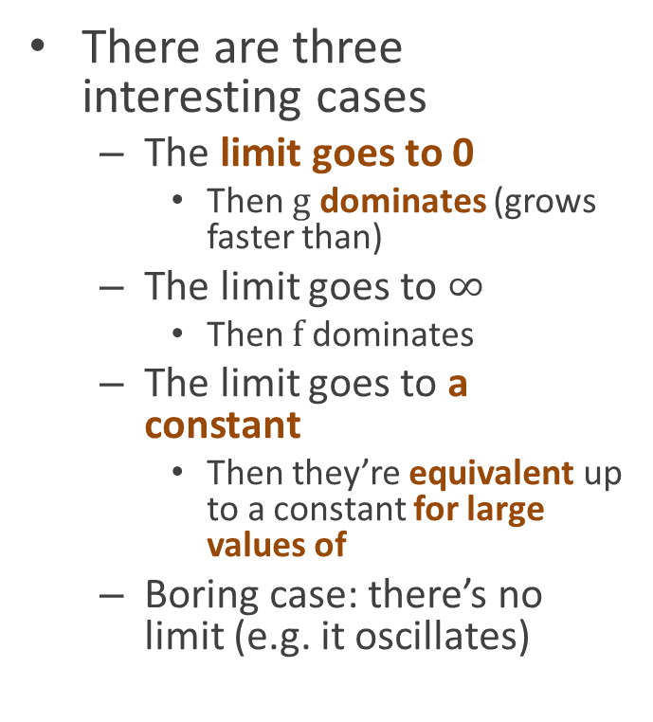
Asymptotic analysis
There are three interesting cases
The limit goes to 0
Then $g$ dominates (grows faster than)
The limit goes to $∞$
Then $f$ dominates
The limit goes to a constant
Then they’re equivalent up to a constant for large values of
Boring case: there’s no limit (e.g. it oscillates)
$$\lim_{n→∞}{\frac{f(n)}{g(n)}}$$

Slide 46
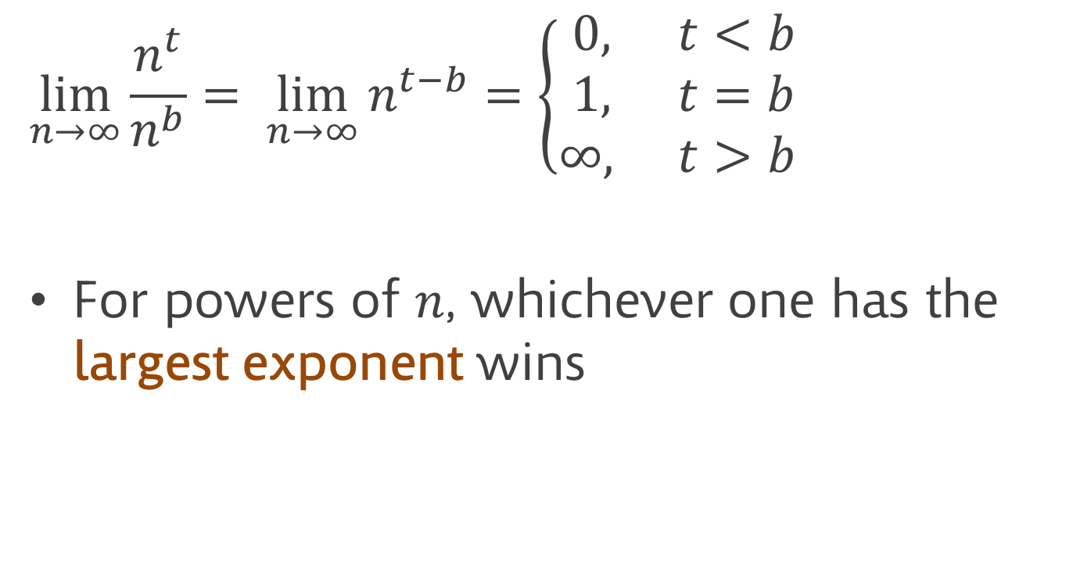
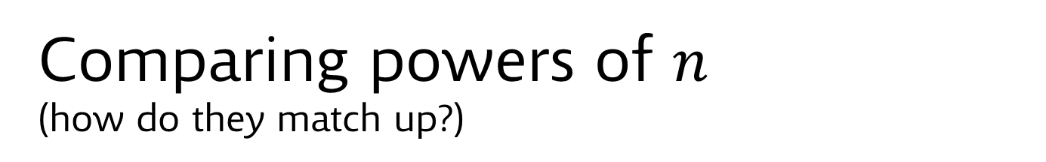
Comparing powers of $n$ (how do they match up?)
$$\lim_{n→∞}{\frac{n^{t}}{n^{b}}= \lim_{n→∞}{n^{t−b}}=\left\{\begin{matrix}0, & t<b \\ 1, & t=b \\ ∞, & t>b\end{matrix}\right.}$$
For powers of $n$, whichever one has the largest exponent wins

Slide 47
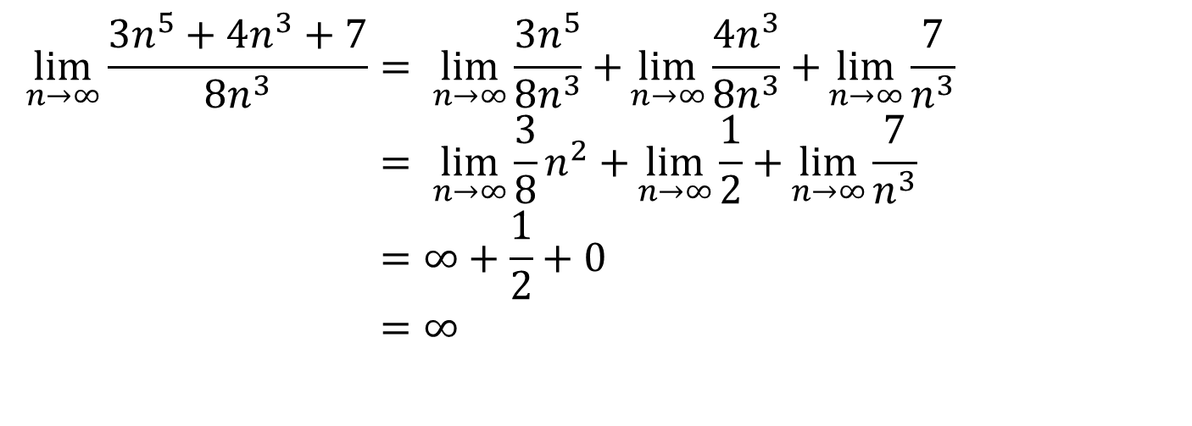
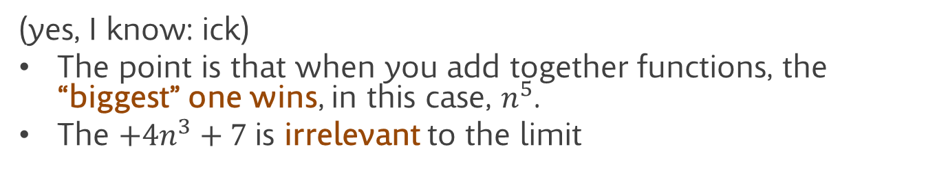
Comparing polynomials (how do they match up?)
$$\lim_{n→∞}{\frac{3n^{5}+4n^{3}+7}{{8n}^{3}}}= \lim_{n→∞}{\frac{3n^{5}}{{8n}^{3}}+}\lim_{n→∞}{\frac{4n^{3}}{{8n}^{3}}+}\lim_{n→∞}{\frac{7}{n^{3}}} \\ = \lim_{n→∞}{\frac{3}{8}n^{2}+}\lim_{n→∞}{\frac{1}{2}+}\lim_{n→∞}{\frac{7}{n^{3}}} \\ =∞+\frac{1}{2}+0 \\ =∞$$
(yes, I know: ick)
The point is that when you add together functions, the “biggest” one wins, in this case, $n^{5}$.
The $+4n^{3}+7$is irrelevant to the limit

Slide 48
What does this mean?
We can roughly rank functions based on the speed with which they increase
Constants grow slowest (given that they, um, don’t grow at all)
Log grows slowly
Linear functions grows a little faster
Quadratics (n²) faster than that
Then other polynomials (e.g. n³)
2^{n} turns out to grow faster than any polynomial
And n! grows still faster

Slide 49
What does this mean?
When comparing a sum, all that matters is the fastest growing part of the sum
Not the other parts
Not any constant it might be multiplied by
Whichever function has the fastest growing term added in is the one that grows fastest

Slide 50
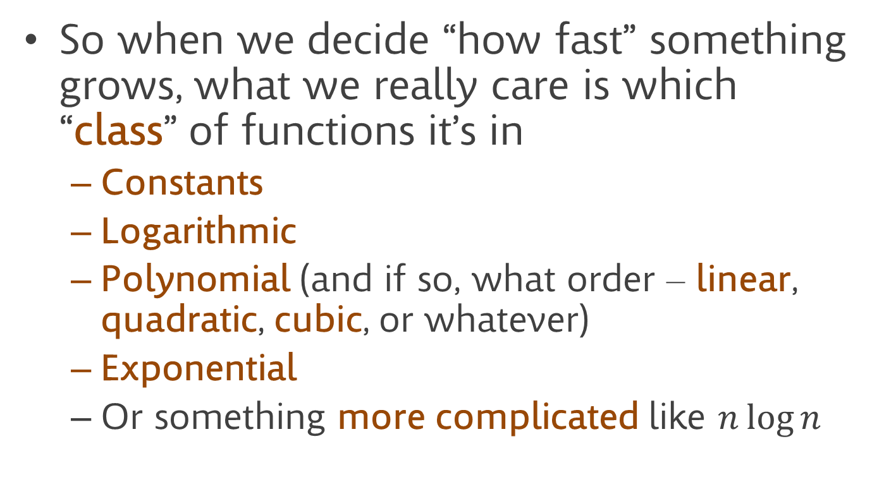
What does this mean?
So when we decide “how fast” something grows, what we really care is which “class” of functions it’s in
Constants
Logarithmic
Polynomial (and if so, what order – linear, quadratic, cubic, or whatever)
Exponential
Or something more complicated like $n\log{n}$

Slide 51
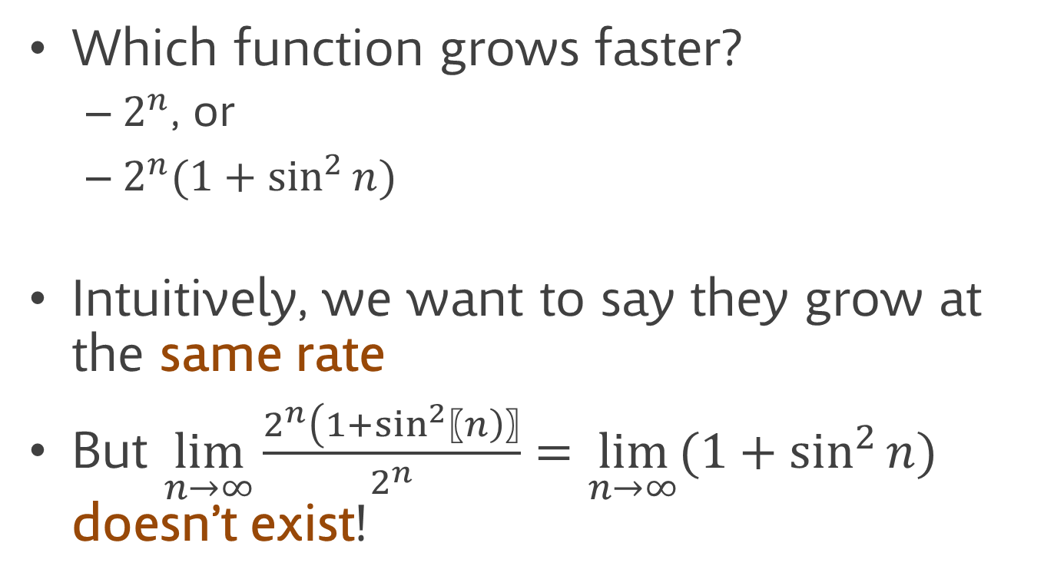
Sometimes limits aren’t appropriate
Which function grows faster?
$2^{n}$, or
$2^{n}(1+\sin^{2}{n})$
Intuitively, we want to say they grow at the same rate
But $\lim_{n→∞}{\frac{2^{n}(1+\sin^{2}{〖n)}〗}{2^{n}}=\lim_{n→∞}{(1+\sin^{2}{n})}}$ doesn’t exist!

Slide 52
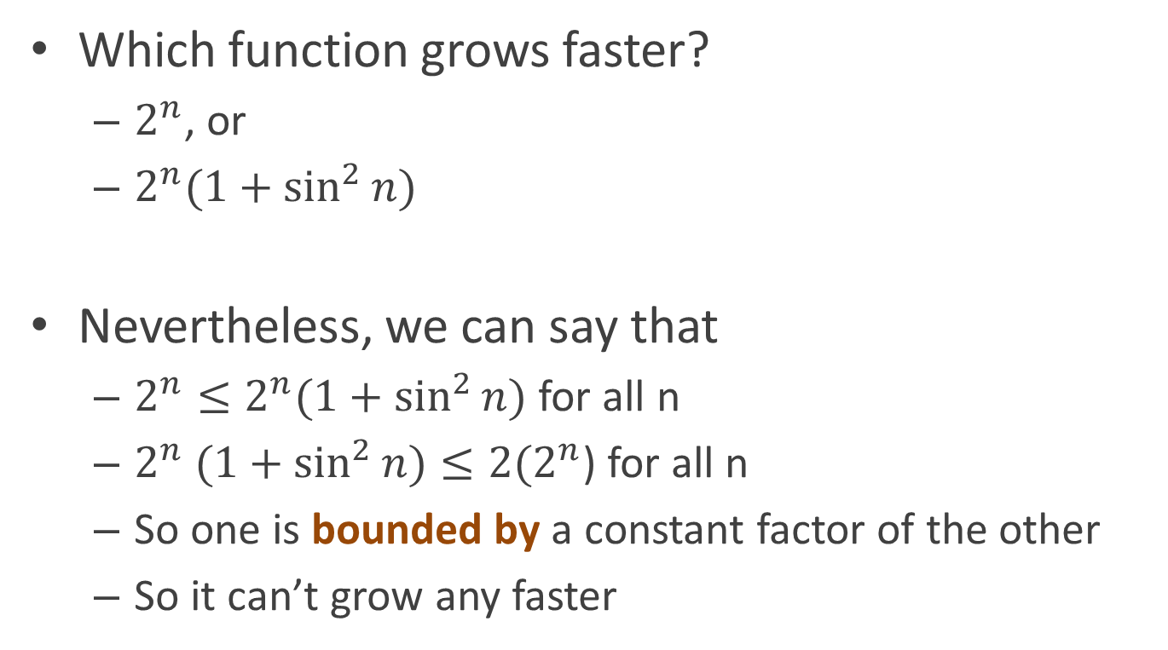
Sometimes limits aren’t appropriate
Which function grows faster?
$2^{n}$, or
$2^{n}(1+\sin^{2}{n})$
Nevertheless, we can say that
$2^{n}≤2^{n}(1+\sin^{2}{n)}$ for all n
$2^{n} (1+\sin^{2}{n)}≤2(2^{n}$) for all n
So one is bounded by a constant factor of the other
So it can’t grow any faster

Slide 53
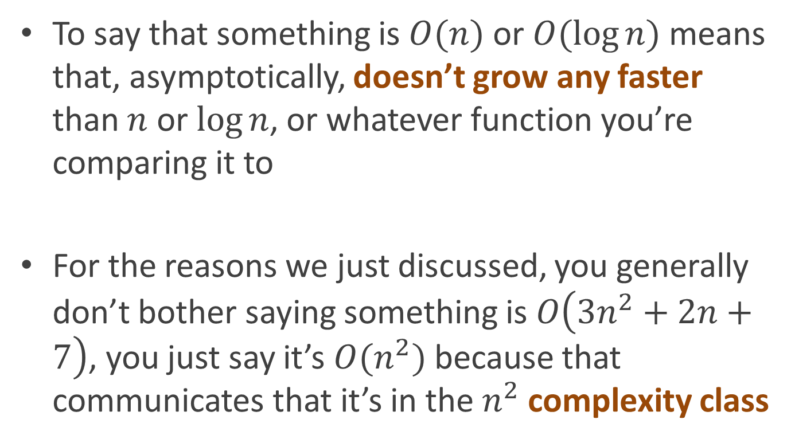
The big O
To say that something is $O(n)$ or $O(\log{n)}$means that, asymptotically, doesn’t grow any faster than $n$ or $\log{n}$, or whatever function you’re comparing it to
For the reasons we just discussed, you generally don’t bother saying something is $O\left(3n^{2}+2n+7\right)$, you just say it’s $O(n^{2})$ because that communicates that it’s in the $n^{2}$ complexity class

Slide 54
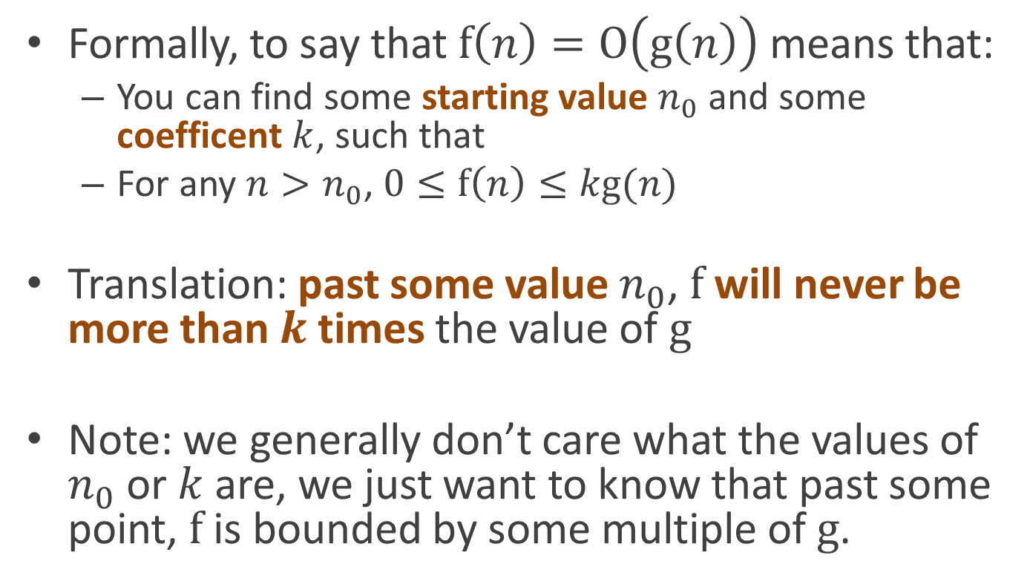
The big O
Formally, to say that $\text{f}\left(n\right)=\text{O}\left(\text{g}\left(n\right)\right)$ means that:
You can find some starting value $n_{0}$ and some coefficent $k$, such that
For any $n>n_{0}$, $0≤\text{f}\left(n\right)≤k\text{g}(n)$
Translation: past some value $n_{0}$, $\text{f}$ will never be more than $k$ times the value of $g$
Note: we generally don’t care what the values of $n_{0}$ or $k$ are, we just want to know that past some point, $f$ is bounded by some multiple of $g$.

Slide 55

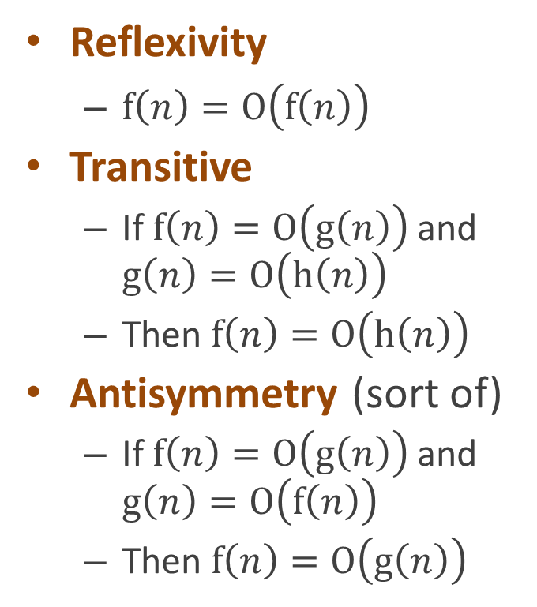



Big O is essentially a partial order
Reflexivity
$f\left(n\right)=O\left(f\left(n\right)\right)$
Transitive
If $f\left(n\right)=O\left(g\left(n\right)\right)$ and $g\left(n\right)=O\left(h\left(n\right)\right)$
Then $f\left(n\right)=O\left(h\left(n\right)\right)$
Antisymmetry (sort of)
If $f\left(n\right)=O\left(g\left(n\right)\right)$ and $g\left(n\right)=O\left(f\left(n\right)\right)$
Then $f\left(n\right)=O\left(g\left(n\right)\right)$
All functions
$$O(2^{n})$$
$$O(\text{polynomial})$$
$$O(n^{2})$$
$$O(n)$$

Slide 56
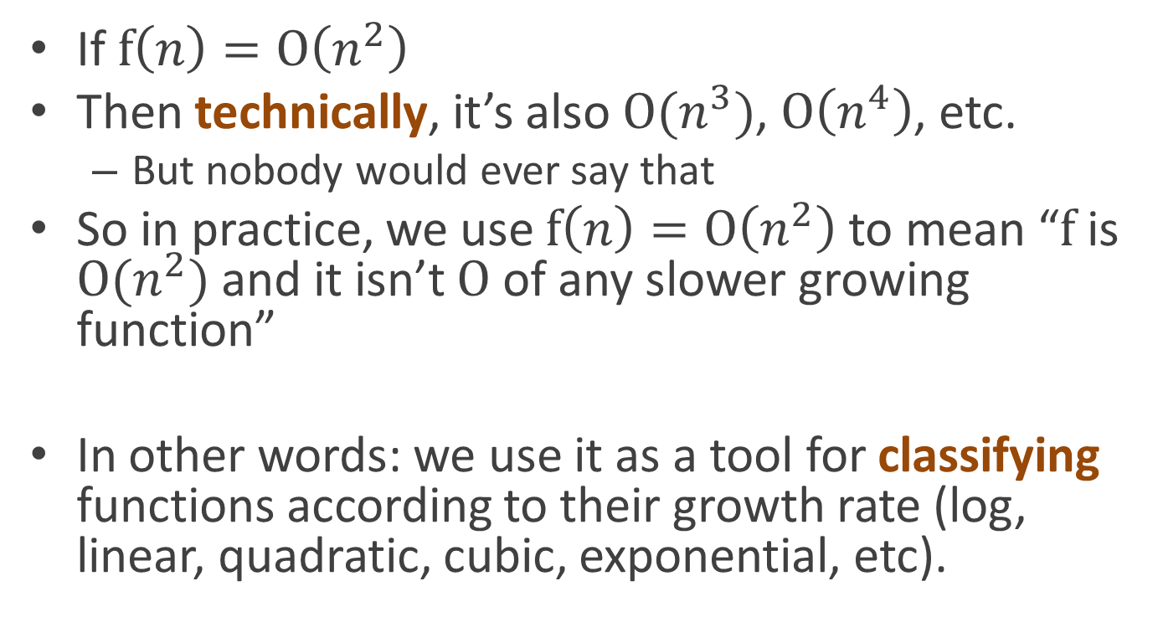
But we use big O as if it were an equivalence relation
If $f\left(n\right)=O\left(n^{2}\right)$
Then technically, it’s also $O(n^{3})$, $O\left(n^{4}\right)$, etc.
But nobody would ever say that
So in practice, we use $f\left(n\right)=O\left(n^{2}\right)$ to mean “$f$ is $O(n^{2})$ and it isn’t $O$ of any slower growing function”
In other words: we use it as a tool for classifying functions according to their growth rate (log, linear, quadratic, cubic, exponential, etc).

Slide 57
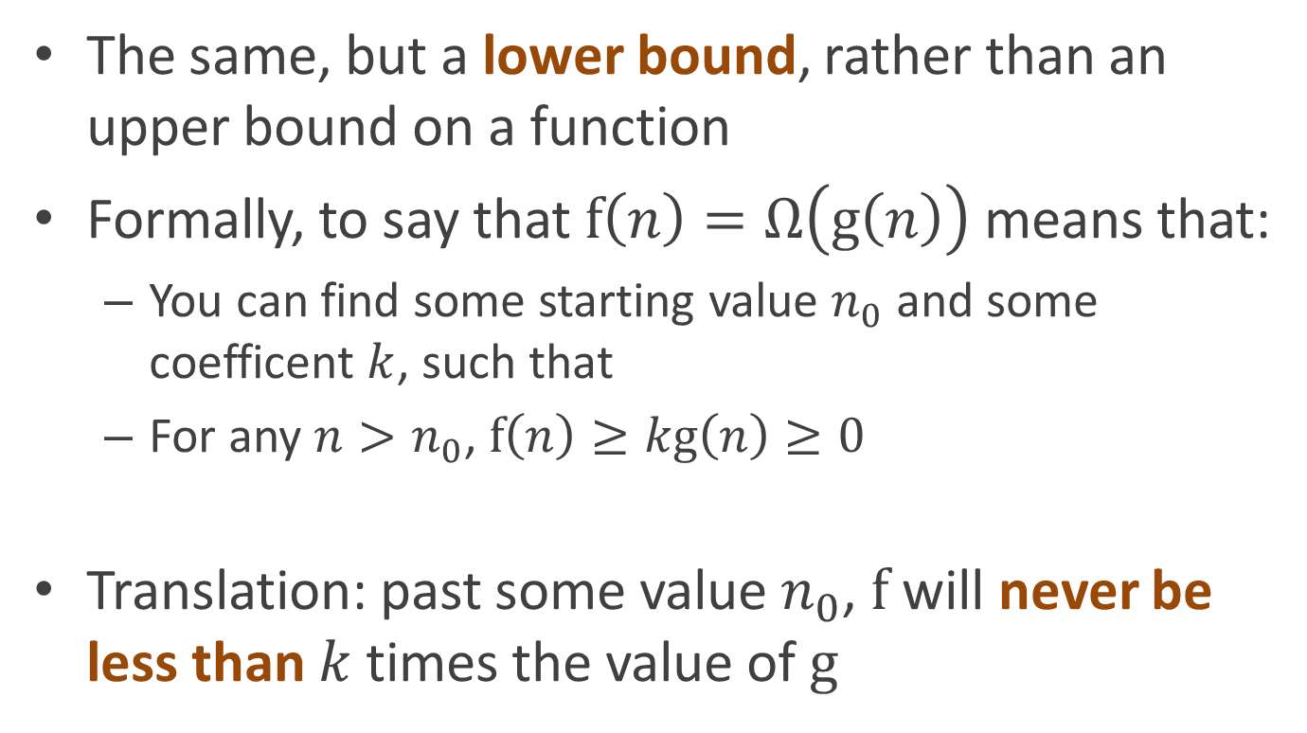
Lower bounds
The same, but a lower bound, rather than an upper bound on a function
Formally, to say that $f\left(n\right)=Ω\left(g\left(n\right)\right)$ means that:
You can find some starting value $n_{0}$ and some coefficent $k$, such that
For any $n>n_{0}$, $f\left(n\right)≥kg\left(n\right)≥0$
Translation: past some value $n_{0}$, $f$ will never be less than $k$ times the value of $g$

Slide 58
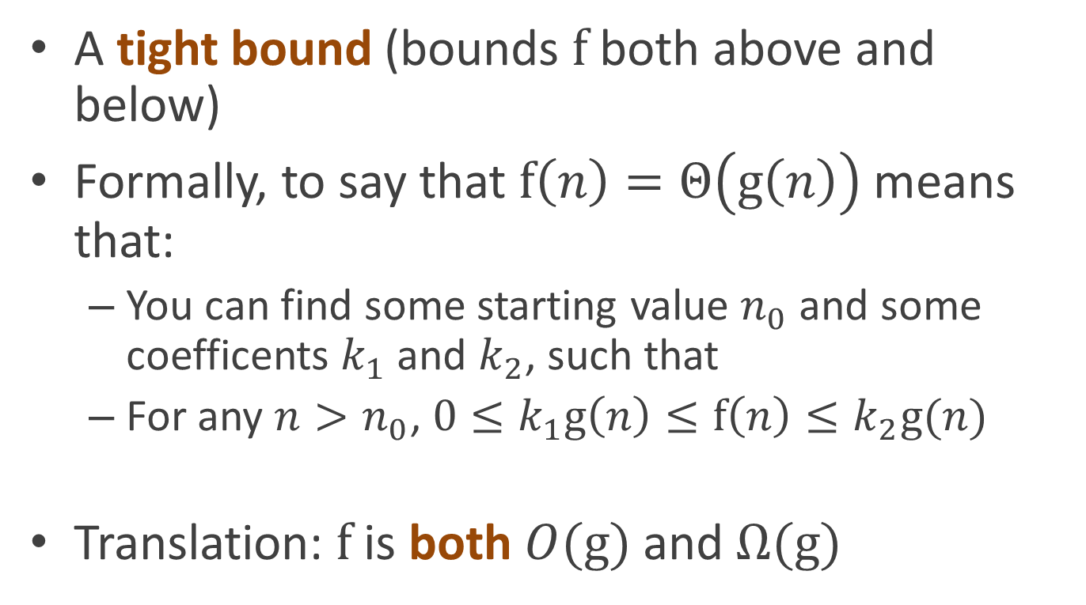
Theta (nice, but harder to prove)
A tight bound (bounds $f$ both above and below)
Formally, to say that $f\left(n\right)=Θ\left(g\left(n\right)\right)$ means that:
You can find some starting value $n_{0}$ and some coefficents $k_{1}$ and $k_{2}$, such that
For any $n>n_{0}$, ${0≤k}_{1}g\left(n\right)≤f\left(n\right)≤k_{2}g(n)$
Translation: $f$ is both $O(g)$ and $Ω(g)$

Slide 59
Optional reading
Introduction to Algorithms, chapter 3 (“Growth of functions”)

